Slide 1


Eduardo Schiavo
3/11/2021

Slide 2

Outline
Executive Summary
Introduction
Methodology
Results
Conclusion
Appendix

Slide 3
Executive Summary
Exploratory Data Analysis is carried out on a Space X dataset (via webscraping, interactive visualization, dashboard building, geographical data visualization etc.)
Different Data Visualization techniques allow us to rationalize what are the factors affecting the successful landing of the first stage.
This has a direct economical impact, as the possible reutilization of the first stage is the main factor that makes Falcon 9 launches much cheaper that all the other space programs

Slide 4

Introduction
A Falcon 9 Launch from Space X costs 62$ million
Launches from other companies cost > 165$ million
The main difference stems from the fact that Falcon 9 can reuse the first stage…
…if it lands without blowing up
We can investigate which factors affect the correct landing of the First Stage in order to increase the number of successful landings!

Slide 5


Slide 6
Methodology
Executive Summary
Data collection methodology:
Data was collected mainly through requests to the Space X API
Perform data wrangling
A landing Class with values 0/1 for unsuccessful/successful landing was created
Am Orbit column was added, containing the target orbit for the Payload.
Perform exploratory data analysis (EDA) using visualization and SQL
Perform interactive visual analytics using Folium and Plotly Dash
Perform predictive analysis using classification models
How to build, tune, evaluate classification models

Slide 7
Data Collection
Data sets were collected via the Space X API and through Webscraping
WIKIPEDIA PAGE
Webscraping with
BeautifulSoup
URL CONTAINING DATA
https://api.spacexdata.com/v4/launches/past
Requests via
Space X REST API
PANDAS DATAFRAME
JSON FILE
Data Wrangling

Slide 8
Data Collection – SpaceX API
Scheme of Space X REST API Data collection
Notebook link:
https://github.com/EduardoSchiavo/AppliedDataScienceCapstone/blob/83b78656bf8eeede3a8f6cfa84b4c472d650a17a/DataCollactionAPI.ipynb
GET REQUEST
response = requests.get(spacex_url)
CHECK STATUS CODE
(200 == success!)
response.status_code
CONVERT TO PANDAS DATAFRAME
tmp=response.json() data=pd.json_normalize(tmp)

Slide 9
Data Collection - Scraping
GET REQUEST
response = requests.get(spacex_url)
Webscraping scheme
Notebook link:
https://github.com/EduardoSchiavo/AppliedDataScienceCapstone/blob/83b78656bf8eeede3a8f6cfa84b4c472d650a17a/Webscraping.ipynb
CONVERT TO BS4 OBJECT
html_data=BeautifulSoup(response.text, "html.parser")
ISOLATE RELEVANT TABLE
html_tables=html_data.find_all('table’)
first_launch_table = html_tables[2]
CONVERT TO PD DATAFRAME
See notebook for code

Slide 10
Data Wrangling
Exploratory Data Analysis (EDA) is performed in order to find patterns in the data
(i.e. the number of launches per orbit and per site are counted)
The dataset is processed in order to have suitable labels for the subsequent training of supervised machine learning (ML) models
(i.e. the mission outcomes are converted in a Class entry)
Notebook link:
https://github.com/EduardoSchiavo/AppliedDataScienceCapstone/blob/83b78656bf8eeede3a8f6cfa84b4c472d650a17a/EDA.ipynb

Slide 11
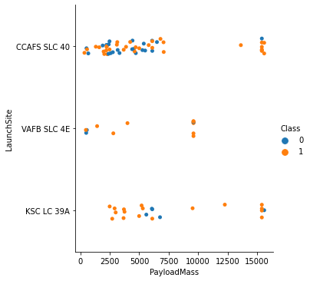
EDA with Data Visualization
The following relationships are visually explored:
Launch Sites vs. Flight Number
Launch Sites vs. Payload Mass
Orbit Type vs. Success Rate
Orbit Type vs. Flight Number
Orbit Type vs. Payload Mass
Class vs. Year
Notebook link:
https://github.com/EduardoSchiavo/AppliedDataScienceCapstone/blob/83b78656bf8eeede3a8f6cfa84b4c472d650a17a/EDA%20with%20DATA%20Visualization.ipynb

Slide 12
EDA with SQL
EDA was performed through S QL queries, in particular:
Launch site names
Launches from sites starting with CCA
Payload mass carried by NASA CRS boosters
Average payload mass carried by F9 v1.1 boosters
Date of first successful landing outcome
Name of boosters with succesfuls outcome and payload mass in a certain range

Slide 13
EDA with SQL
Total number of successes and fails
Booster versions that have carried out the maximum payload mass
Failed landing outcomes in drone ship, their booster versions, and launch site names for in year 2015
Ranked the count of landing outcomes (such as Failure (drone ship) or Success (ground pad)) between the date 2010-06-04 and 2017-03-20, in descending order
Notebook link:
https://github.com/EduardoSchiavo/AppliedDataScienceCapstone/blob/83b78656bf8eeede3a8f6cfa84b4c472d650a17a/EDA%20with%20SQL.ipynb

Slide 14
Build an Interactive Map with Folium
On a map we marked:
-launch sites
-success and fails for launch sites
-distances between a launch site to its proximities
This allows us to visualize the sites with the highest rate of success and to assess the risk due the proximities of human settlements and or infrastructures. See notebook for further details
Notebook link:
https://github.com/EduardoSchiavo/AppliedDataScienceCapstone/blob/83b78656bf8eeede3a8f6cfa84b4c472d650a17a/EDA%20with%20SQL.ipynb

Slide 15
Build a Dashboard with Plotly Dash
A simple dashboard was created, visualizing the outcomes for launch site and the outcome against payload mass, color coded with respect to the site. A dropdown menu allows for selection of the site and a slider helps us select the payload mass range.
GitHub Link to the python code:
https://github.com/EduardoSchiavo/AppliedDataScienceCapstone/blob/83b78656bf8eeede3a8f6cfa84b4c472d650a17a/spacex_dash.py

Slide 16
Predictive Analysis (Classification)
A Class label was created, data was standardized and split into a training and test set.
Through GridSearchCV we found the best parameters set for:
Logistic Regression, Decision Tree, SVM and KNN
Notebook link:
https://github.com/EduardoSchiavo/AppliedDataScienceCapstone/blob/596da586cda3137638b1ab75b20b009296b9e271/Machine%20Learning%20Prediction.ipynb

Slide 17
Results
Exploratory data analysis results
Interactive analytics demo in screenshots
Predictive analysis results

Slide 18


Slide 19
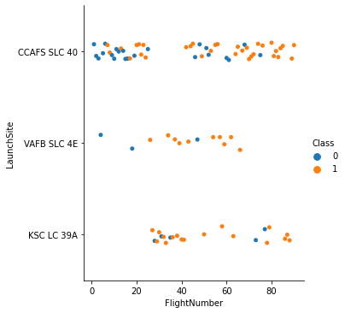
Flight Number vs. Launch Site
For CCAFS SLC 40 there seems to be a correlation between Flight Number and outcome

Slide 20
Payload vs. Launch Site
For VAFB SLC 4E there are no launches with payload mass greater than 10000
In general, there seems to be a higher success rate for larger payloads across all the Lauch Sites

Slide 21
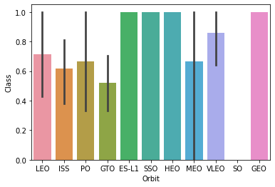
Success Rate vs. Orbit Type
ES-L1 SSO HEO and GEO have the highest success rate

Slide 22
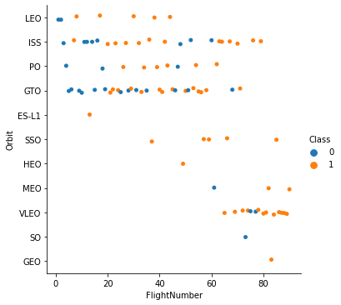
Flight Number vs. Orbit Type
There is a relationship between number of flights and success rate for the LEO orbit
For other orbits (e.g. GTO) this is not the case.
For certain orbits we did not measure unsuccessful flights

Slide 23
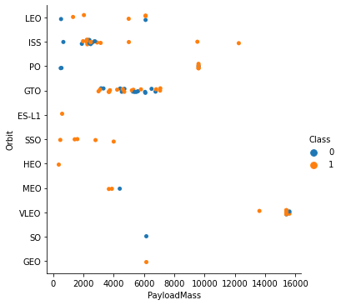
Payload vs. Orbit Type
Again, for GTO we don’t observe any trend
Heavier payloads are more frequently launched to the ISS, PO and VLEO orbits
On ISS and PO we also notice that heavier payloads correlate with a higher rate of success

Slide 24
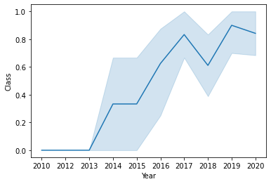
Launch Success Yearly Trend
Launch success generally increases over time

Slide 25
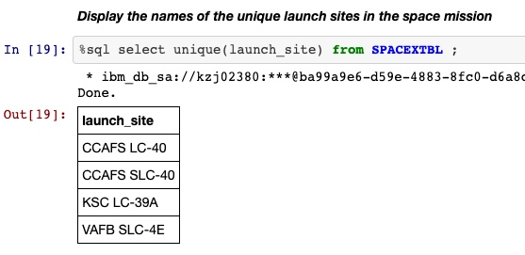
All Launch Site Names
SQL query retrieving the launch sites from a table containing all the data relative to the launches

Slide 26
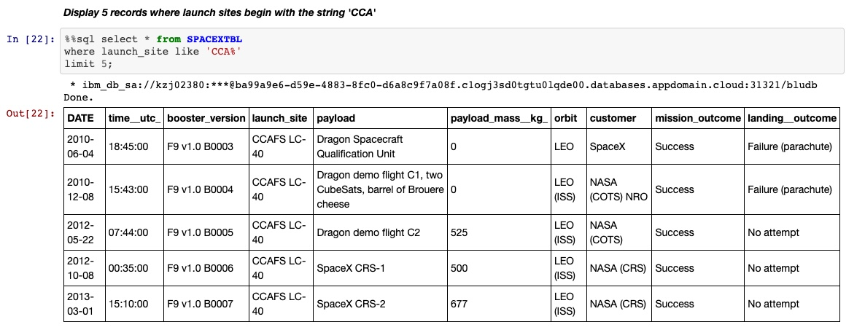
Launch Site Names Begin with 'CCA'
SQL queries all the entries whose launch_site begins with ‘CCA’, then limits output to 5 entries

Slide 27
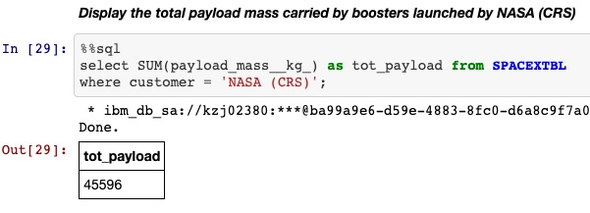
Total Payload Mass
Selecting the sum of the payload mass values of all the entries where customer is equal to ‘NASA (CRS)’

Slide 28
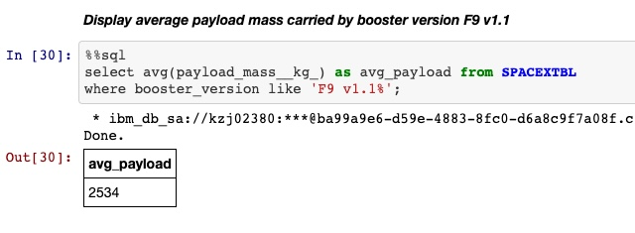
Average Payload Mass by F9 v1.1
Selecting the average of the payload mass values of all the entries where booster version starts with ‘F9 v1.1’

Slide 29
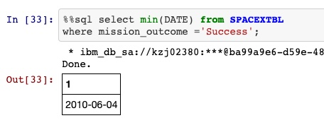
First Successful Ground Landing Date
Querying the minimum of the Data column. The first successful landing occurred on the 04/06/2010

Slide 30
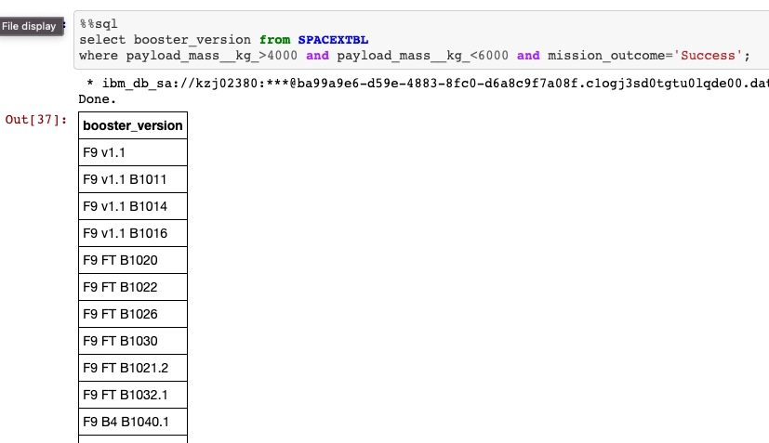
Successful Drone Ship Landing with Payload between 4000 and 6000
List the names of boosters which have successfully landed on drone ship and had payload mass greater than 4000 but less than 6000
The screenshot is cropped to fit into the slides. See the Notebook for the full output.

Slide 31
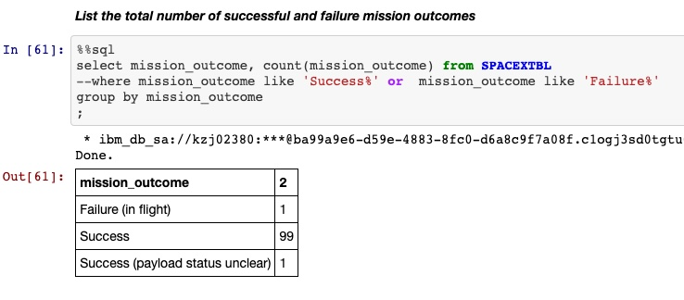
Total Number of Successful and Failure Mission Outcomes
Missions are grouped my mission outcomes and outcomes are counted.
Note that the second line is commented out

Slide 32
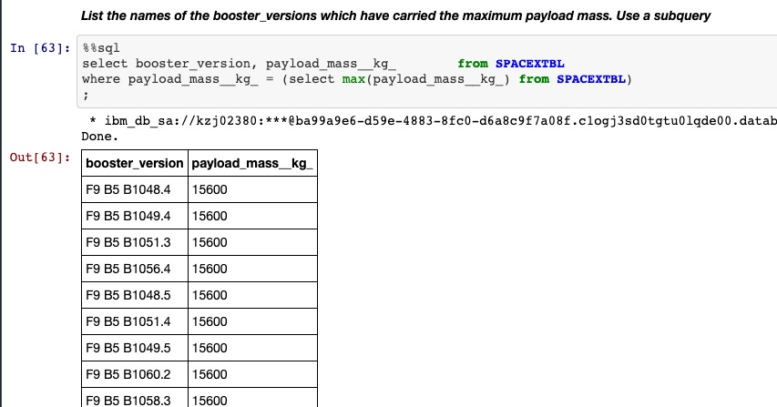
Boosters Carried Maximum Payload
Boosters carrying the maximum payload are queried. The maximum payload is obtained through a subquery to the SPACEXTBL
Not that the output is cropped to fit into the slides. See notebook for the full output

Slide 33
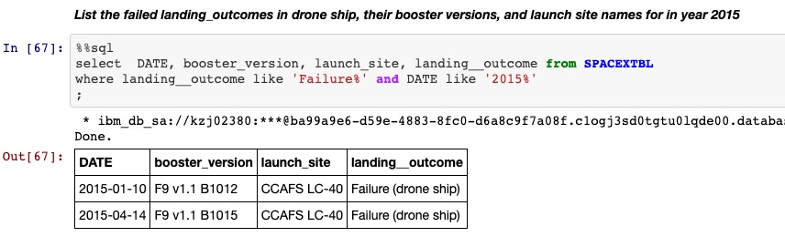
2015 Launch Records
SQL query to all failed llaunches in 2015

Slide 34
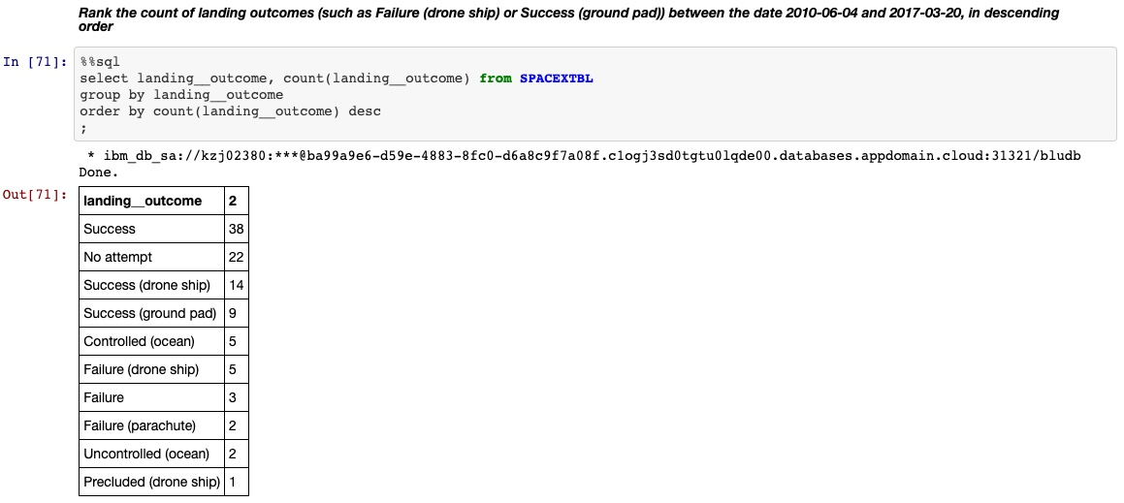
Rank Landing Outcomes Between 2010-06-04 and 2017-03-20
The landing outcome and its counts are queried and grouped by outcome then ordered in descending order

Slide 35


Slide 36
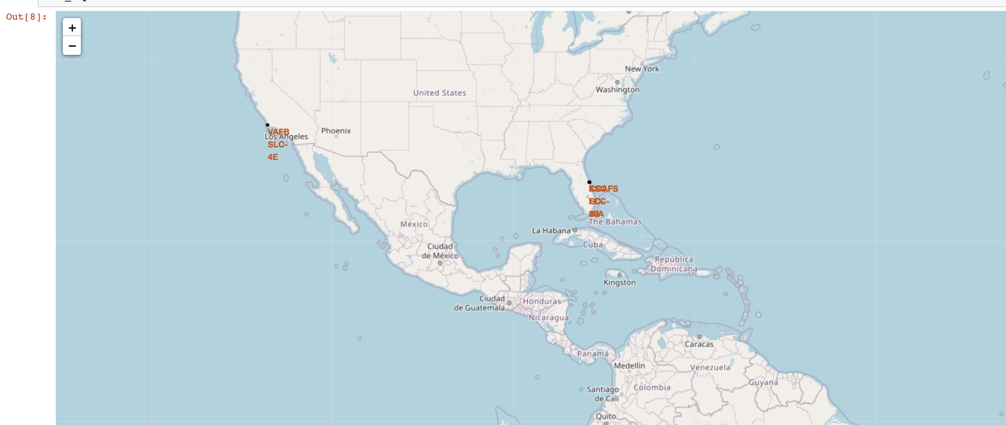
Launch Sites’ Locations
All the launch sites are located in coastal areas in proximity of the equator

Slide 37
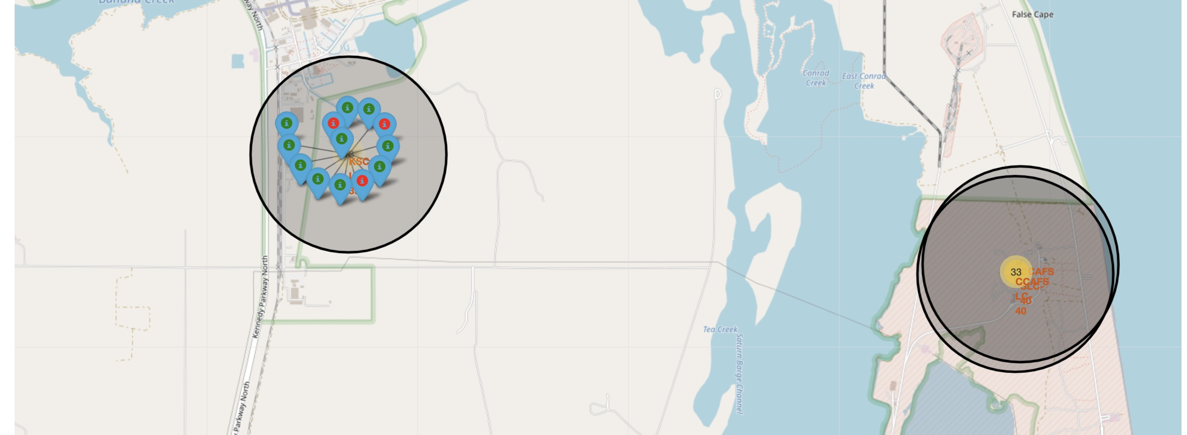
Success rate of Launch sites
The map is color-coded with respect to the success/fail of the missions. It is possible to drill-down and look at the individual color-coded entries

Slide 38
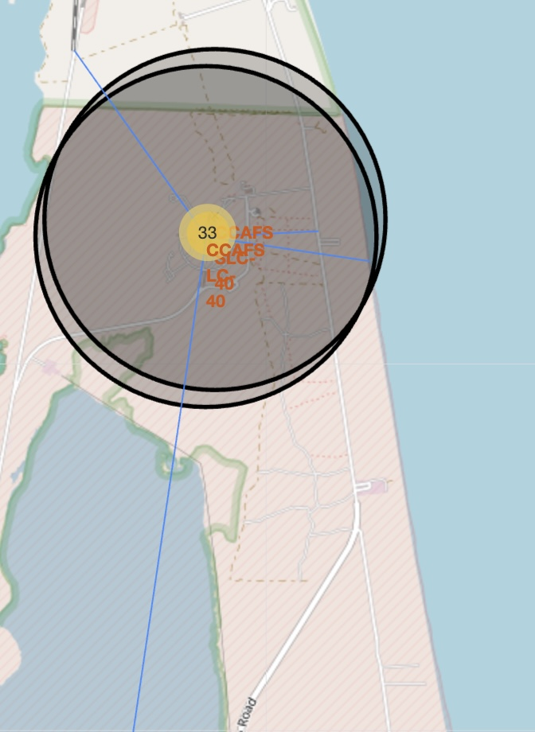
Proximities of Launch Site
The map shows lines connecting launch site CCAFS-LC40 to its proximities
The distances to places like human settlements, railorads, streets and coastline are calculated and highlighted in the map.

Slide 39


Slide 40
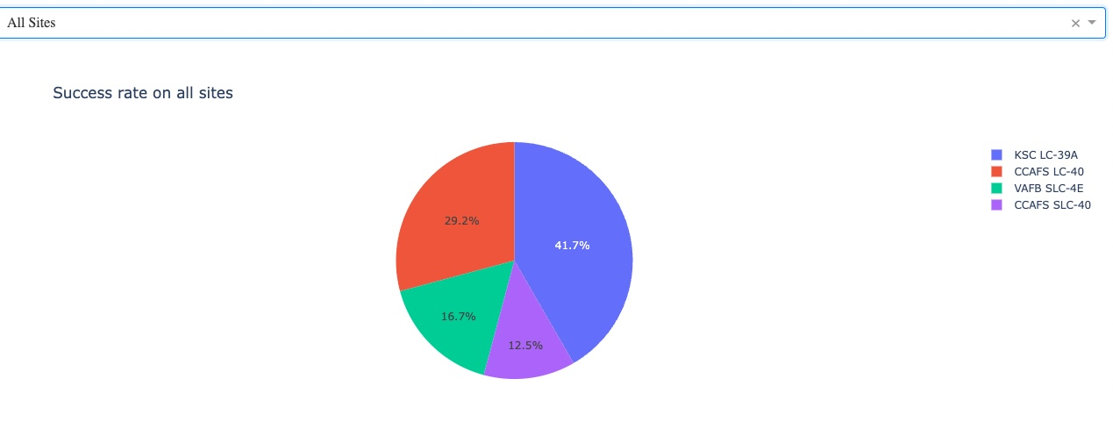
Success Rate on all Sites
KSC LC-39A is clearly the site with the highest number of successful flights

Slide 41
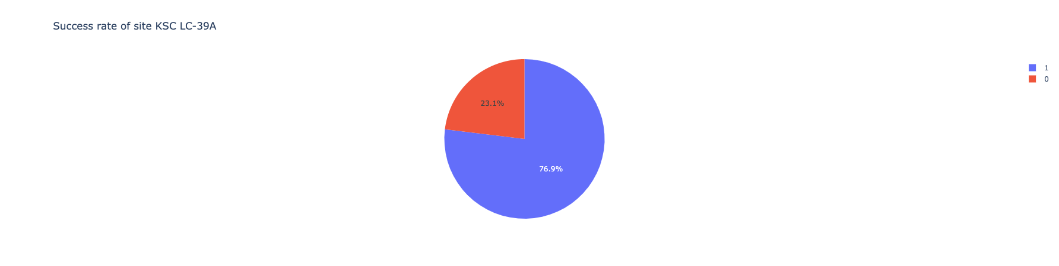
Success Ratio of site KSC LC-39A
40 % of the total successes come from this site
Within the site, 76.9% of the launches have been successful

Slide 42
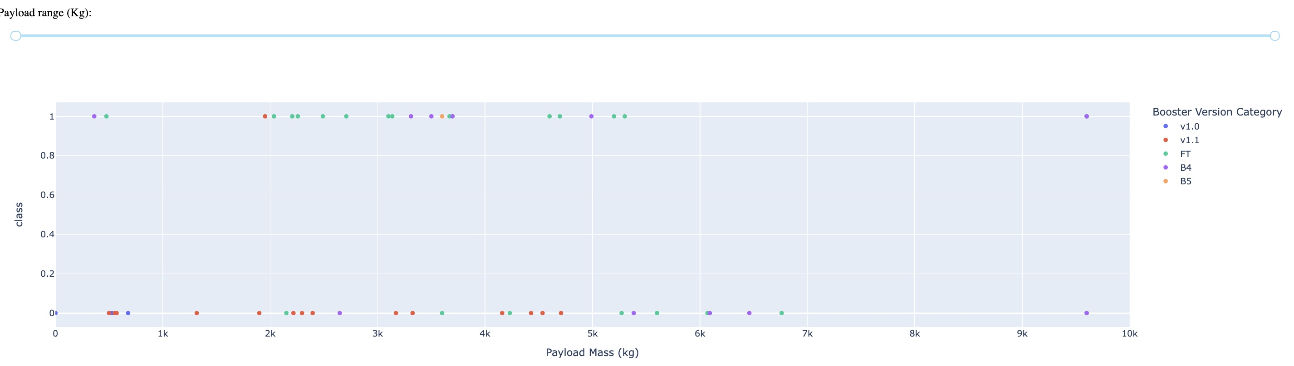
Success vs Payload
We can see how different booster types have different success rate depending on the mass payload

Slide 43
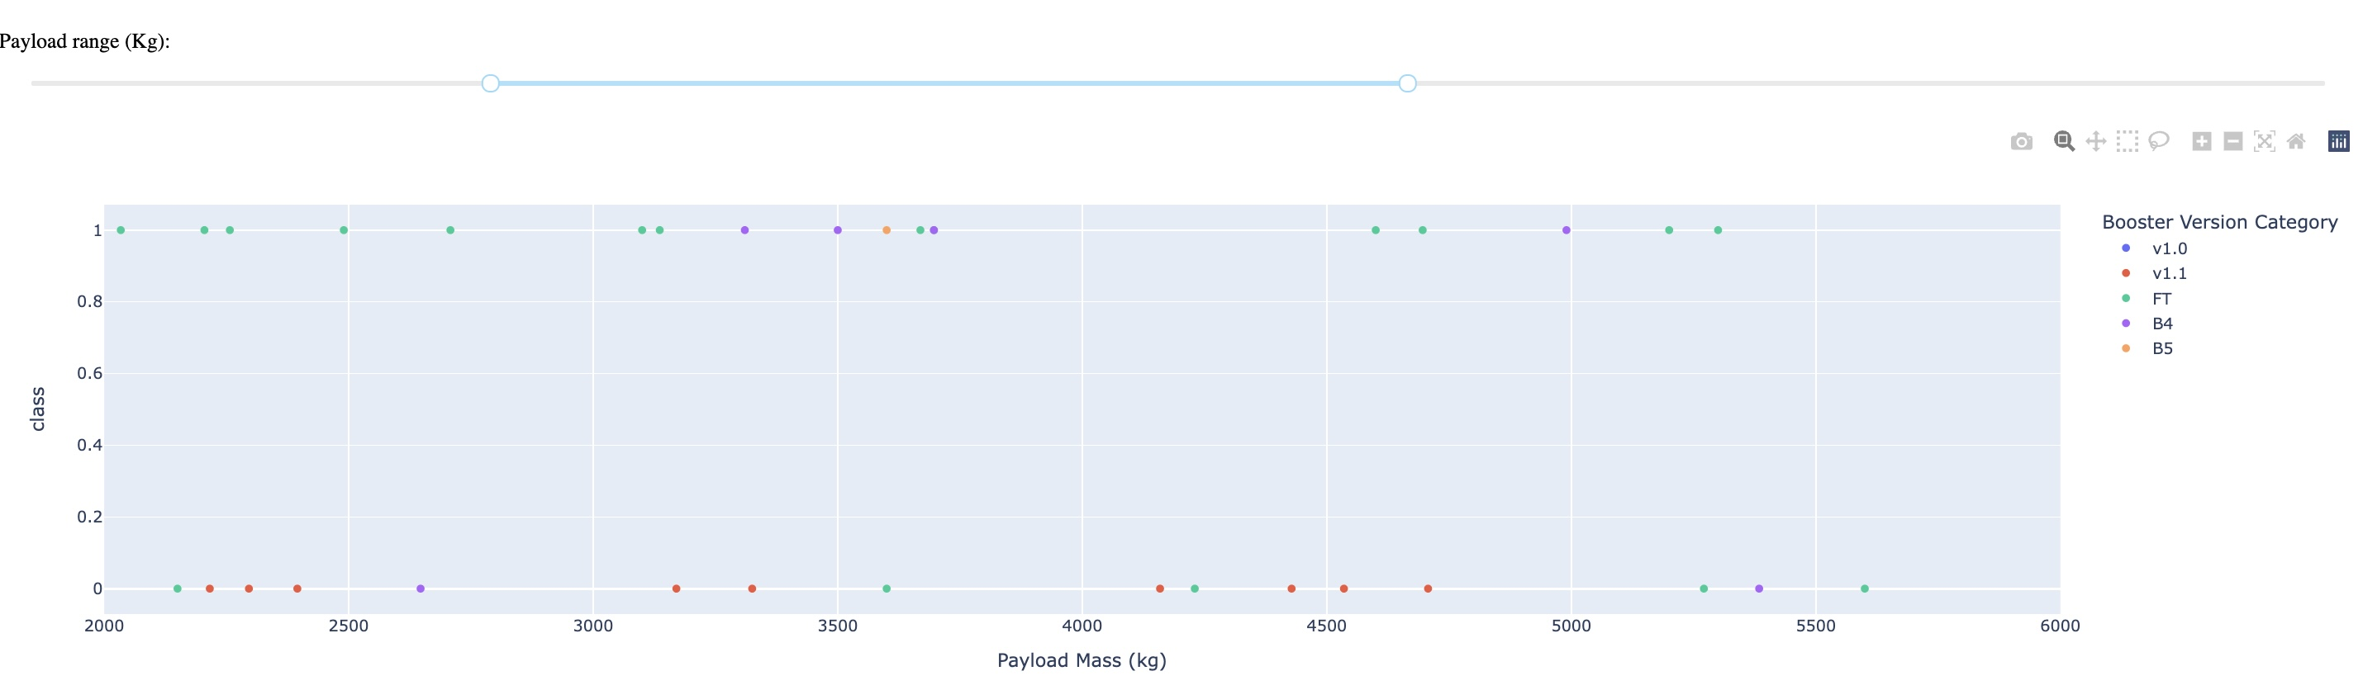
Success vs Payload
In particular, most successful launches are obtained in the 2000 – 5500 kg range, with the FT booster version

Slide 44


Slide 45
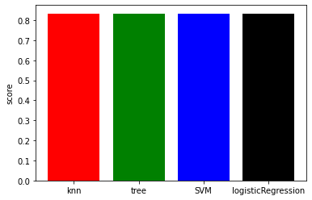
Classification Accuracy
All the models have the same score of about 0.833

Slide 46
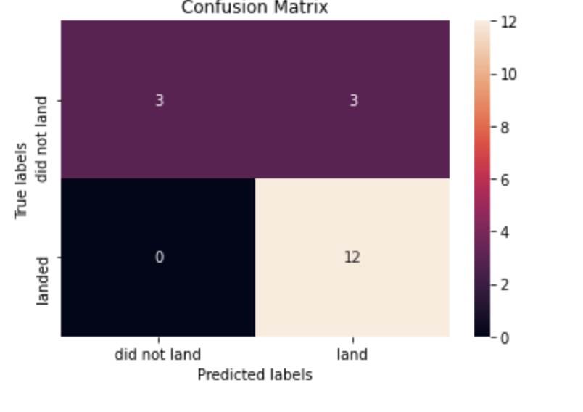
Confusion Matrix
Here is the confusion matrix of one of the methods
The major problem here are the 12 false positive results

Slide 47
Conclusions
EDA allows us to have a first impression of which factors affect a successful landing of the first stage. The latter being the major reason for the relative low cost of space X missions
Launch site, Payload mass and target orbit are among the main factors
KSC-LC39 A is the site with the highest success rate
Low Payload launches are most successful when launched to the SSO, while High Payloads have a better chance of success when launched to PO and ISS
A general increase of success rate over time is observed
All the classification models tested performed in the same way, with some issues due to the high number of false positives

Slide 48
Appendix
The following github page contains all the code used for the analysis presented so far:
https://github.com/EduardoSchiavo/AppliedDataScienceCapstone

Slide 49


